Slide 1
2. Order Circuit and
Bode Plots
Circuit Theory
AUE 2007
Bo Rohde Pedersen

Slide 2
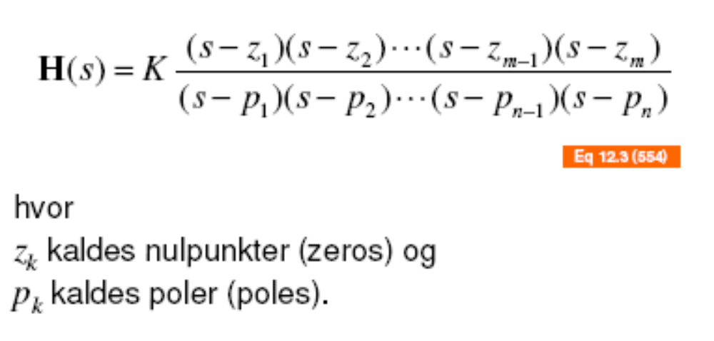
Transfer functions
En samling af 1. ordens kredsløb

Slide 3
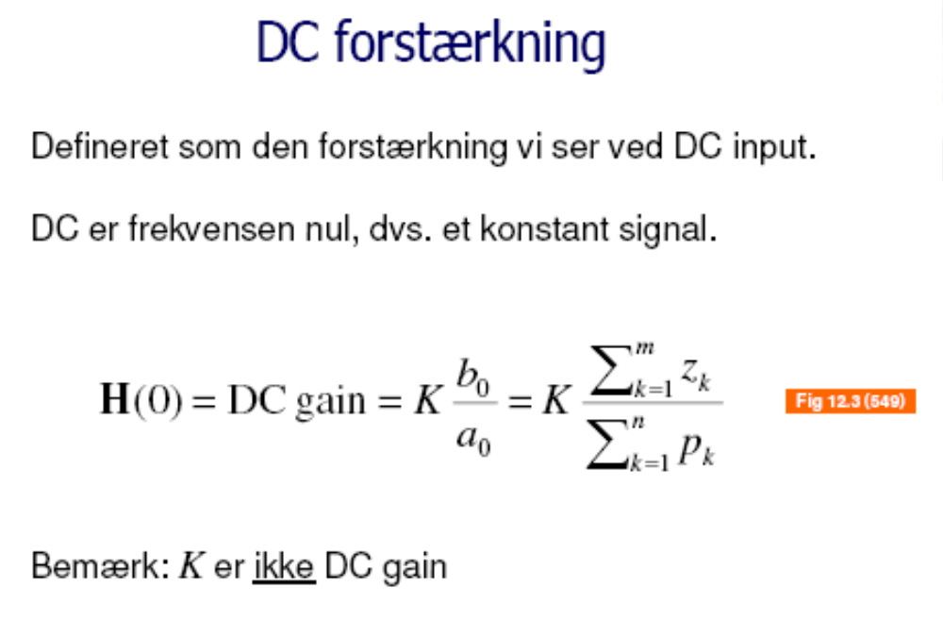

Slide 4
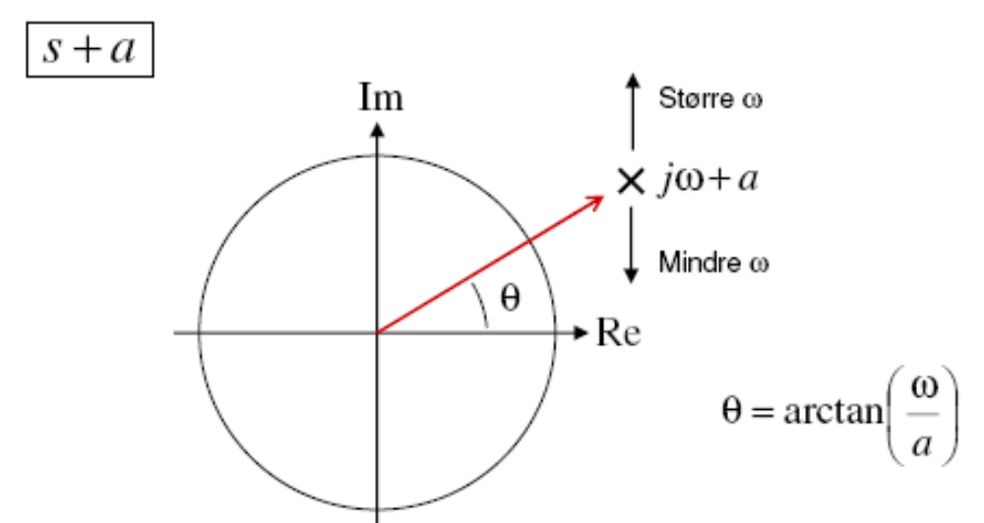
Phase

Slide 5
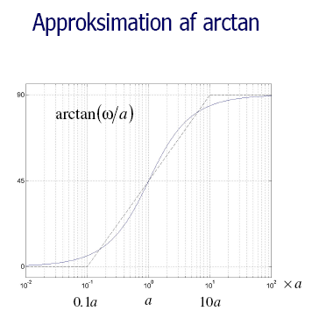

Slide 6
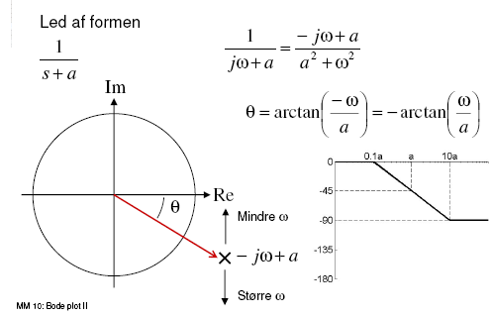
Phase

Slide 7
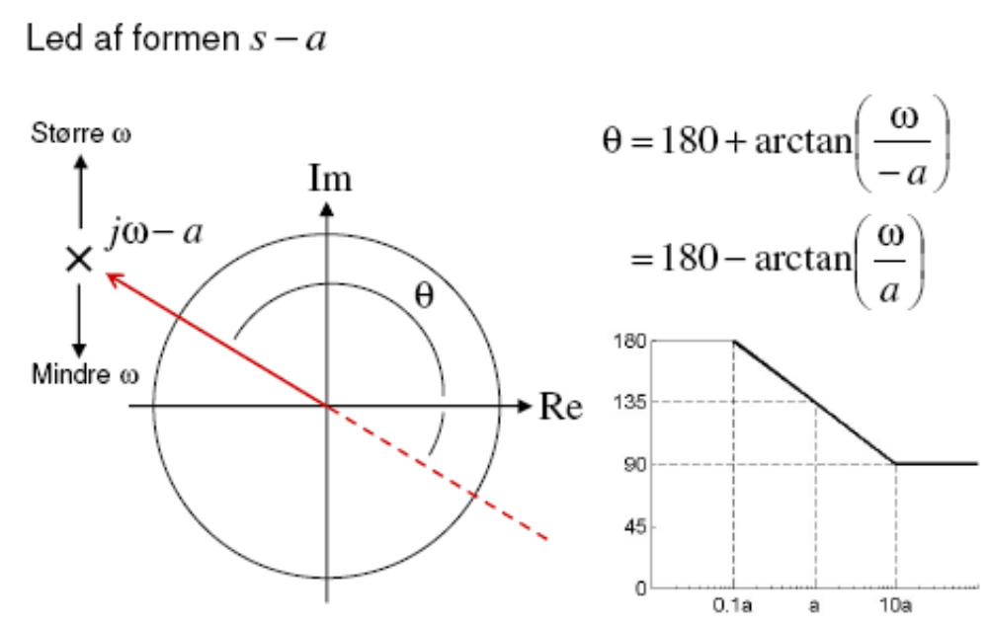
Phase

Slide 8
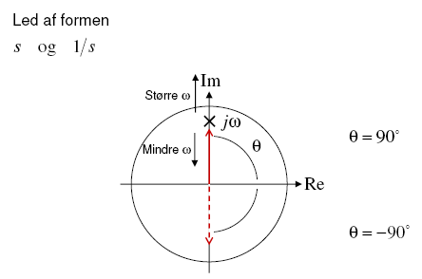
Phase

Slide 9
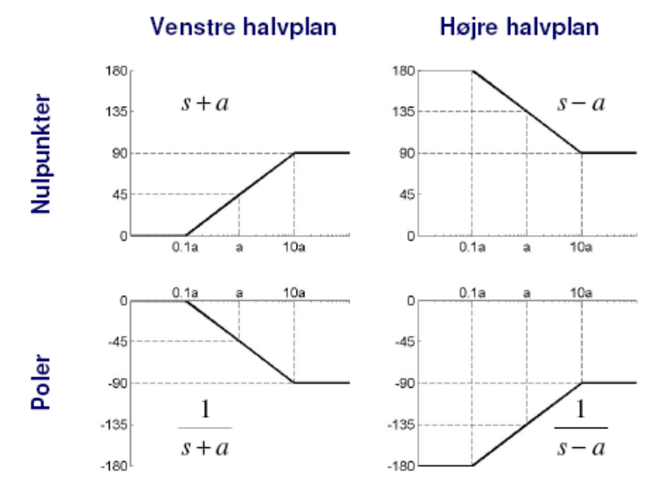

Slide 10


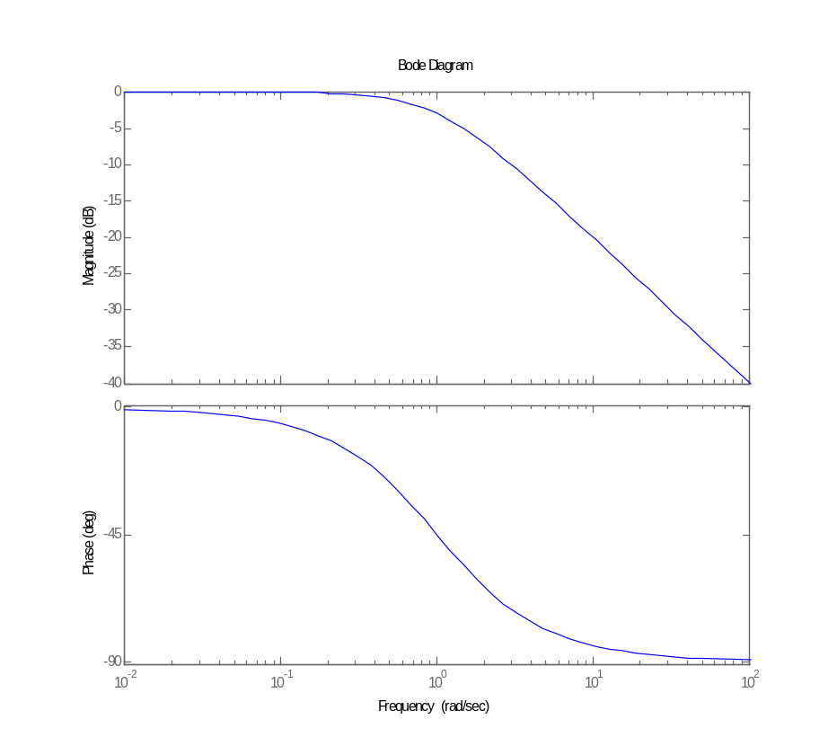
Bode plot
Magnitude -> Modulus
Phase -> Argument

Slide 11
Drawing Bode Plots From Transfer Function
By hand
  Write transfer function poles (s-α) and zeros (s-β)
  Draw the Low/and high frequency lines
  3 dB difference by pole or zeros

Slide 12
Adding Two Filters
Example:

Slide 13
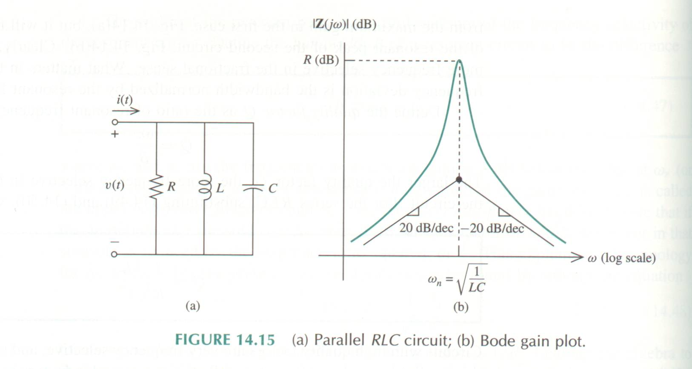
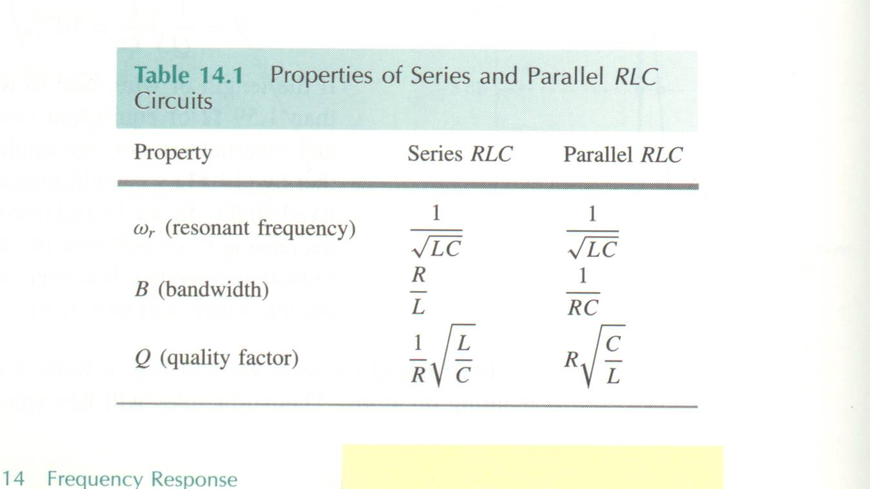
Series and Parallel RLC Circuits

Slide 14
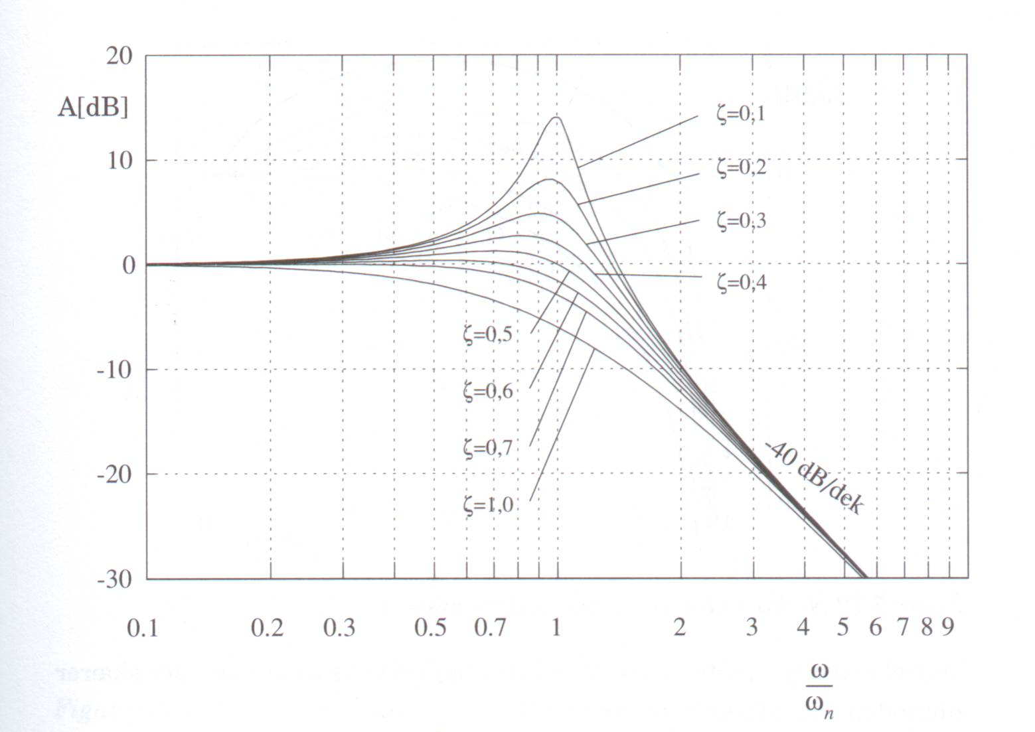
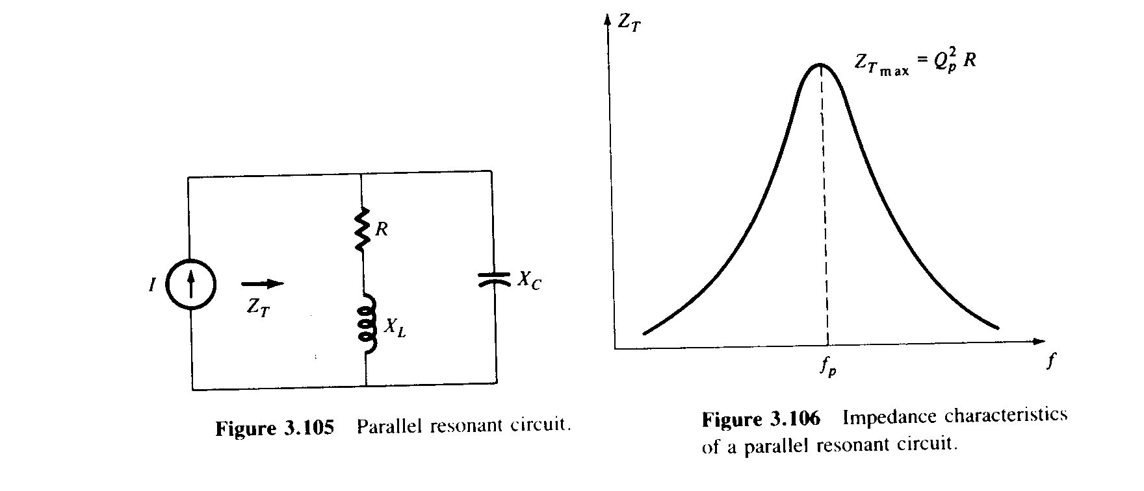
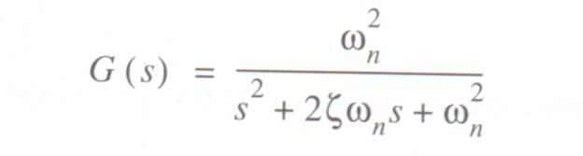
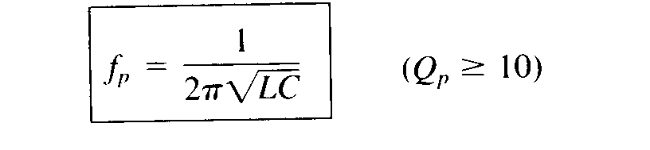
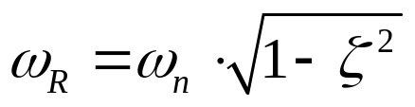
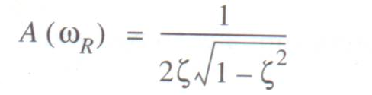
Second Order Systems,
Frequency Domain
Natural frequency:
ω_{n} is the natural frequency
ω_{R} is the resonance frequency

Slide 15
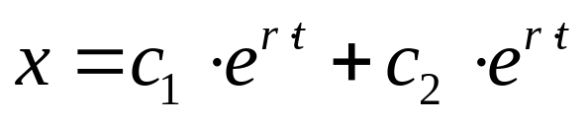
2. order system Time domain
Complex 2. order system
Input step response

